Slide 1
Fiscal Policy
  It is the prime lever of economic stabilization policy by influencing aggregate demand in the economy to achieve higher economic growth, full employment and price stability
  Fiscal policy is the manipulation of government spending and taxation.
- Balanced (G =T)
- Expansionary (G>T)
- Contractionary (G<T)

Slide 2
Debates: procyclical v/s countercyclical
Pro-cyclical
– Keeps cycle going
spending goes up (taxes go down) in booms and spending goes down (taxes go up) in recessions.
– Private sector “damage control” actions
Countercyclical
– Changes cycle’s direction
– Public sector actions
Fiscal policy is generally procyclical in emerging market economies (EMEs) (Ilzetzki and Vegh, 2008), as against being countercyclical in advanced economies (AEs) (IMF, 2009).
Unlike developed countries, fiscal policy in developing countries is procyclical even during (moderate) recessions; in "good times", however, fiscal policy is actually more procyclical in developed economies.
Paolo Manasse, 2006

Slide 3
Why is Fiscal Policy often Procyclical?
We explain this policy failure with a political agency problem. Procyclicality is driven by voters who seek to "starve the Leviathan" to reduce political rents. Voters observe the state of the economy but not the rents appropriated by corrupt governments. When they observe a boom, voters optimally demand more
public goods or lower taxes, and this induces a procyclical bias in fiscal policy. The empirical evidence is consistent with this explanation: procyclicality of fiscal policy is more pronounced in more corrupt democracies.
Alberto Alesina, Filipe Campante and Guido Tabellini, 2008
There is evidence that fiscal policy is expansionary -- a channel disregarded by the existing literature -- lending empirical support to the notion that when "it rains, it pours.”
In the first half of the 20th century, fiscal policy attributed to Keynesian policy - deficiency of AD can be overcome by expansionary fiscal policy - through higher govt. spending
Great Depression 1930s
Rebuilding the war-ravaged economies of Europe and Japan after World War II

Slide 4
Why is Fiscal Policy often Procyclical?
Keynesian policy was challenged in early 1970s due to-
(i) breakdown of the Bretton Woods Agreement
(ii) OPEC oil shock of 1973, and
(iii) mounting inflationary pressure in USA
Economists came with new classical persuasion – Discretionary fiscal policy leads to market distortions
With rising debt and debt problems, fiscal policy lost its importance to being mere demand shock to be addressed through monetary policy (Kuttner, 2002), and monetary policy became dominant as a stabilisation policy in 1990s.

Slide 5
Why is Fiscal Policy often Procyclical?
Monetary policy supplanted fiscal policy in 1990s
Adaptation of the inflation targeting (IT) framework by many central banks and easing of inflation pressures – known as ‘Great Moderation’ – provided credible evidence and intellectual support for dominance of monetary policy until the Global Financial Crisis in 2008.
Despite best efforts of major central banks in reducing interest rates by adoption of quantitative easing (QE) measures, credit conditions remained tight resulting in large scale unemployment in many countries.
Monetary policy became ineffective, and once again fiscal policy gained attention.
However, the effectiveness of fiscal stimulus gets negated in EMEs since policy credibility in these countries is weaker than in AEs.

Slide 6
Discretionary policy
– Legislated changes
Discretionary fiscal policy refers to changes in taxes or spending that are the result of deliberate changes in government policy. (Changes in taxes, spending, etc) in response to economic events)
Automatic stabilizers
– Programs that act counter-cyclically
Automatic stabilizers are revenue and expenditure items in the budget that automatically change with the state of the economy in such a way as to stabilize GDP.
Automatic Stabilizers are :
– Programs for unemployed
– Progressive tax system

Slide 7
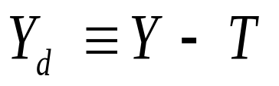


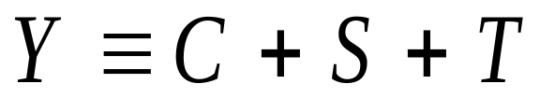

Adding Net Taxes (T) and Government Purchases (G) to the Circular Flow of Income
How? C + I + G
When government enters the picture, the aggregate income identity gets cut into three pieces:

Slide 8

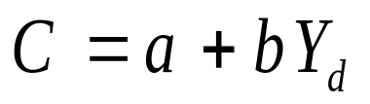
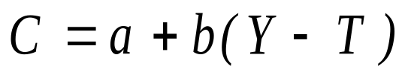
Adding Taxes to the Consumption Function
With taxes a part of the picture, the aggregate consumption function is a function of disposable, or after-tax, income.

Slide 9
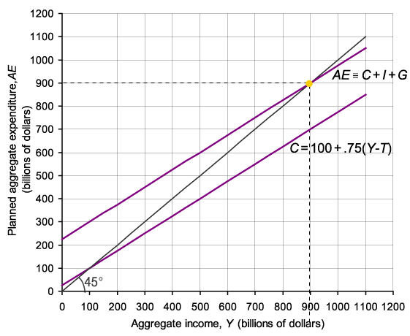
Finding Equilibrium Output/Income

Slide 10



The Leakages/Injections Approach
Taxes (T) are a leakage from the flow of income. Saving (S) is also a leakage.
In equilibrium, aggregate output (income) (Y) equals planned aggregate expenditure (AE), and leakages (S + T) must equal planned injections (I + G). Algebraically,

Slide 11
COUNTERING RECESSION
AE increases via
– G increase
– C increase and/or
– I increase
AE change x multiplier = Equilibrium change
G change = AE change
– G up $100 = AE up $100
– Assume multiplier = 4
– $100 x 4 = $400 change in equilibrium

Slide 12
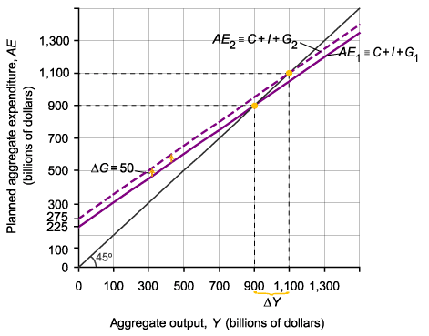
The Government Spending Multiplier

Slide 13
If govt expenditure goes up by 1 unit, this translates to a more than one unit increase in aggregate demand
Under closed economy, Y(1-C) = I+G
If ∆G is the increase in govt expenditure, marginal propensity to consume is c, the change in output is ∆Y is k times ∆G, where is the fiscal multiplier, k= 1/(1-c)
In an open economy, Y=C{Y-t(Y)}+I+G+X-M(Y)
Then (∆Y/∆G)=[1/{(c(1-t)+m}]=multiplier
m is the marginal propensity to import and t is the rate of tax on income
Leakages of imports reduce the power of government expenditure in an open economy

Slide 14
The Tax Multiplier
A tax cut increases disposable income, which is likely to lead to added consumption spending. Income will increase by a multiple of the decrease in taxes.
However, a tax cut has no direct impact on spending.

Slide 15
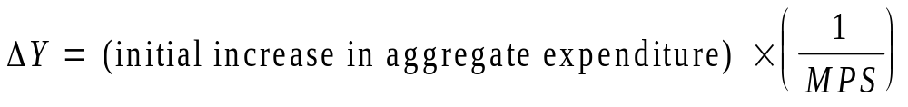
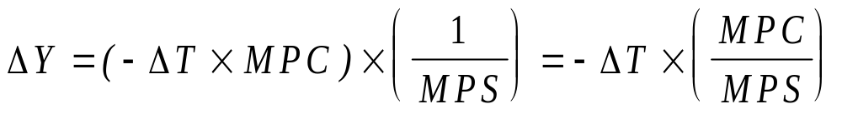
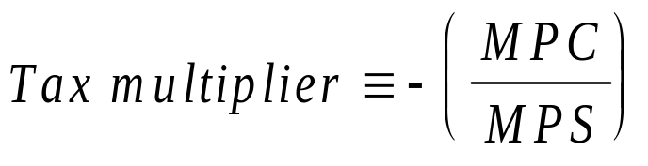
The Tax Multiplier
The tax multiplier for a change in taxes is smaller than the multiplier for a change in government spending.

Slide 16
The Balanced-Budget Multiplier
The balanced-budget multiplier is the ratio of change in the equilibrium level of output to a change in government spending where the change in government spending is balanced by a change in taxes so as not to create any deficit.

Slide 17
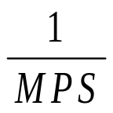
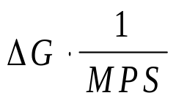
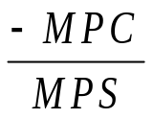
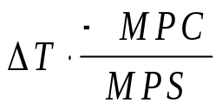

Fiscal Policy Multipliers
Summary of Fiscal Multiplier
 | POLICY STIMULUS | MULTIPLIER | FINAL IMPACT ON EQUILIBRIUM Y
Government- spending multiplier | Increase or decrease in the level of government purchases:
Tax multiplier | Increase or decrease in the level of net taxes:
Balanced-budget multiplier | Simultaneous balanced-budget increase or decrease in the level of government purchases and net taxes: | 1

Slide 18
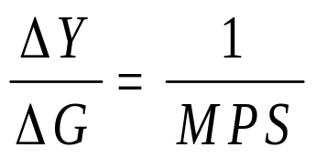
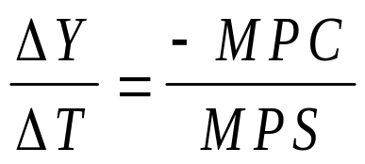
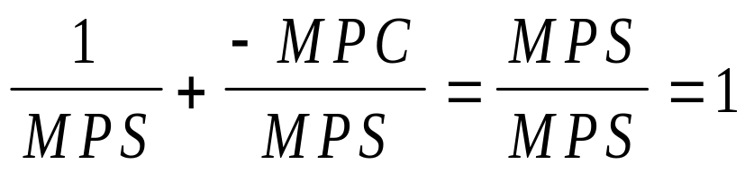
The Balanced-Budget Multiplier
Balanced Budget Multiplier
If we combine the effects of the government spending multiplier and the tax multiplier, we obtain:
Multiplier of
government
spending
Tax
multiplier
and
then:
A simultaneous increase in government spending by $1 and lump-sum taxes by $1 will increase equilibrium income by $1.

Slide 19


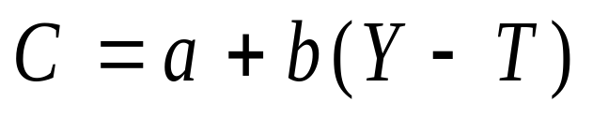
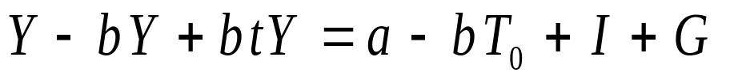

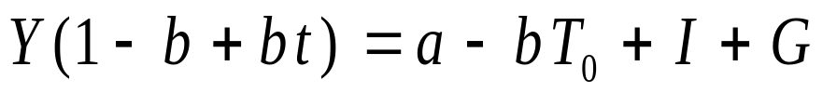
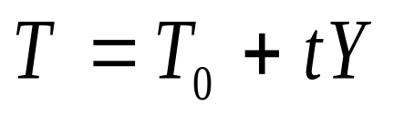
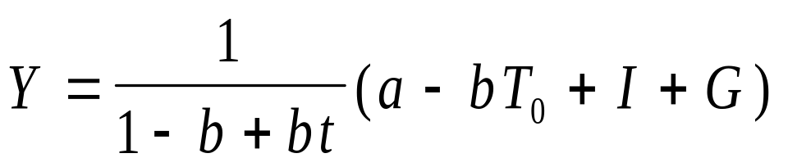
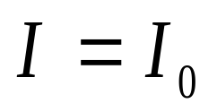
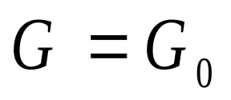
The government spending and tax multipliers
Tax as a function of income
The government spending and tax multipliers:
multiplier

Slide 20



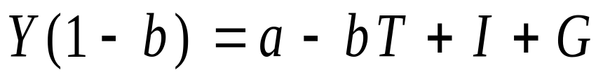
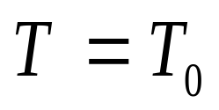
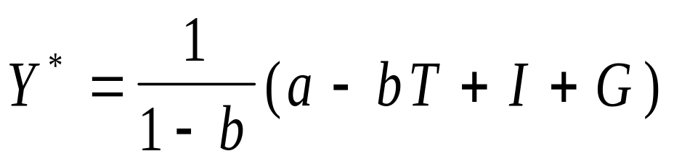
The government spending and tax multipliers are derived algebraically as follows:

Slide 21
Countering Inflation
AE decrease via
– G decrease
– C decrease
– I decrease
AE change x multiplier = Equilibrium change

Slide 22
COUNTERING INFLATION
G change = AE change
– G -$100 = AE -$100
– Assume multiplier = 4
– -$100 x 4 = -$400 in equilibrium

Slide 23
Effects of Fiscal Policy
I. An increase in Govt purchase
Effects:
Leads to increase in demand
C is unchanged as Y – T is not affected
Supply remaining unchanged
This must be met by a decrease in investment
This requires interest to rise
Other effects:
Because tax has not increased
Increased govt purchase is financed by borrowing (Reducing public savings)
With pvt savings unchanged, national savings fall
Interest rates rise to bring about equilibrium between S and I
Rise in interest rate may create crowding out

Slide 24
II. A decrease in Taxes Effects:
A rise in disposable income by ΔT
C rises by ΔT X MPC
Higher MPC leads to higher C
Given production and govt purchases,
There is decrease in investment
Thus interest must rise

Slide 25
IS Curve
Govt purchase multiplier
Taxation multiplier
Increase income
Increase interest

Slide 26
Some Basic Definitions
Revenue Receipts: Tax Revenue+ Non-tax Revenue (Direct taxes + indirect taxes + interest receipts + total profits)
Capital Receipts: Recoveries of loans+ other capital receipts+ borrowing and other liabilities
Revenue Expenditure: Non plan exp on revenue a/c + plan exp on revenue a/c
Capital expenditure: Non plan exp on capital a/c + plan exp on capital a/c

Slide 27
Some Basic Definitions
Plan Expenditure: Current Development and Investment Outlays (both revenue a/c and capital a/c)
Non-plan Expenditure: Interest payments+ subsidies + defense exp (both revenue a/c and capital a/c)
Revenue Deficit: revenue exp – revenue receipts
Fiscal Deficit: total exp – (revenue receipts + recoveries of loan + other capital receipts)= borrowing and other liabilities
Primary Deficit: fiscal deficit – interest payments

Slide 28
Fiscal Policy in India
India is one of the emerging market economies which is semi-open and growing very fast. India’s fiscal system has reformed significantly since early 1990s, with several ups and downs.
2nd half of 1980s: Govt pursued expansionary fiscal policy
  Average fiscal deficits ran about 8% of GDP
Gross fiscal deficit (Centre and States)
  1990-91: 9.1% (centre: 6.42%; states: 3.17%)
  2009-10: 9.43% (centre: 6.46%; states: 3.01%)
  2020-21: 9.2% (centre 5.27%; states: 4%)
  Targeted Central fiscal deficit: 6.8%
Fiscal Deficit of a select comparable countries in Dec 2020:
  China: 6.5%
  Brazil: 14%
  USA: 15.2%
  Numbers are high; one of the main reasons is Covid-19.

Slide 29
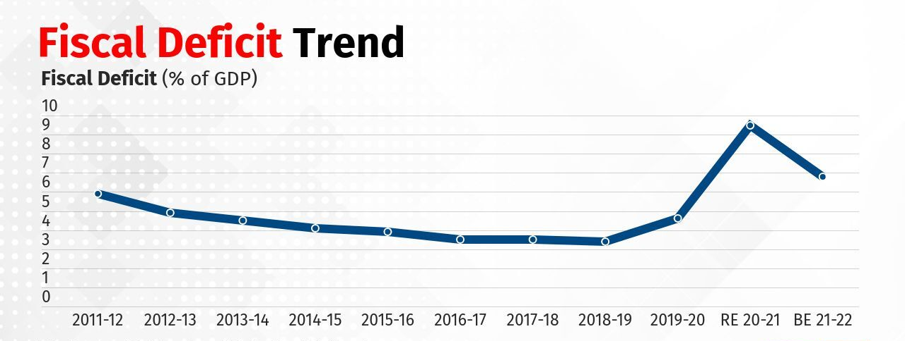
Jump due to Covid 19

Slide 30
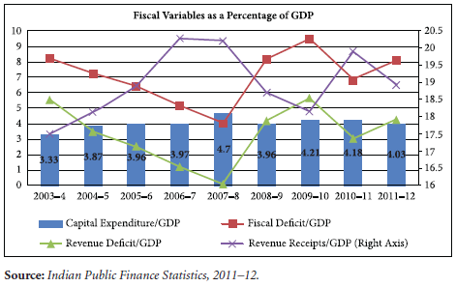
The ratio of revenue receipts-to-GDP rose steadily between 2003-04 and 2007-08 and then declined- one of the reasons being tax concessions (Bose and Bhanumurthy, 2015)

Slide 31
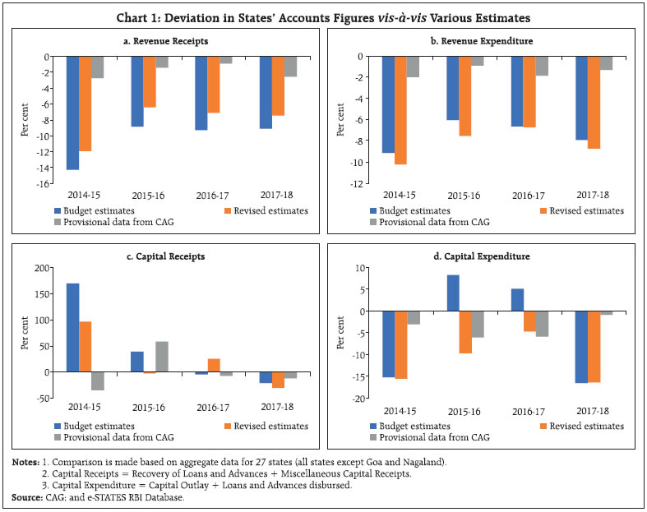
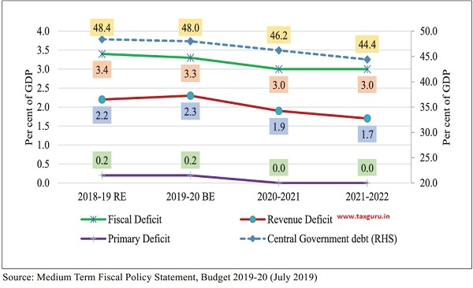

Slide 32
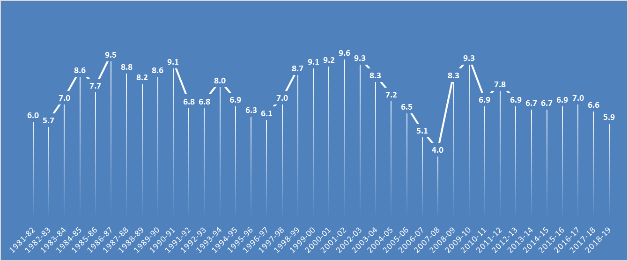
Gross Fiscal Deficit (Combined Central and States)
Source: RBI, 2019
Fiscal Deficit = Total Expenditure-(Revenue Receipts + Capital Receipts)
2020-21 financial year it is Rs.12.48 lakh crore (RBI, 2020)

Slide 33
Cont…
Foreign exchange reserve:
$1.2 bl in January 1991
Above $633 bl in the end of 2021
India’s general govt debt as a percentage of GDP
1991: 75.33%
2020-21: 76% (Central share: 66.6%)
Central govt debt: Internal: 71.6%; External:5.6%
  During 2020 general govt debt as a percentage of GDP in
  Japan: 234.18%
  Greece: 181.60%
  Italy: 127.50%
  Purtugal: 137.4%
  USA: 82%
  China: 61.7%
  Indonesia: 40%

Slide 34
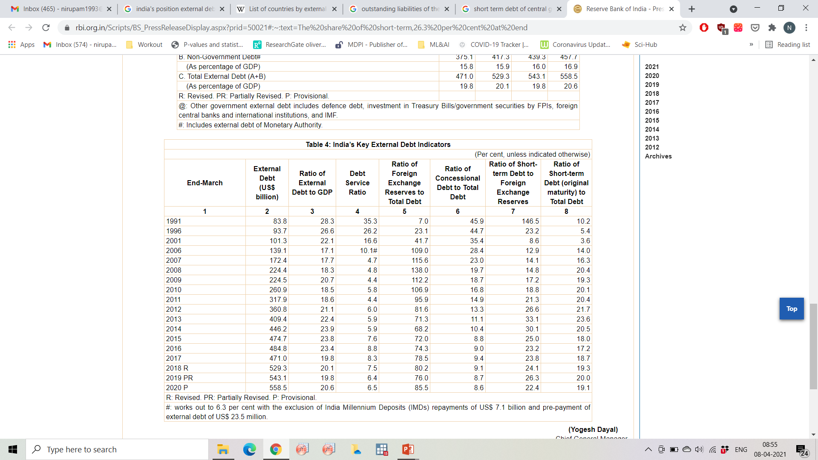
External debt
According to World Bank (2020), India ranks nineteen in terms of absolute external debt amongst the top 20 nation after US tops the list and China at 8th.
Among BRICS countries, in terms of indebtedness, India is at fourth position after China, Brazil and Russian Federation.

Slide 35
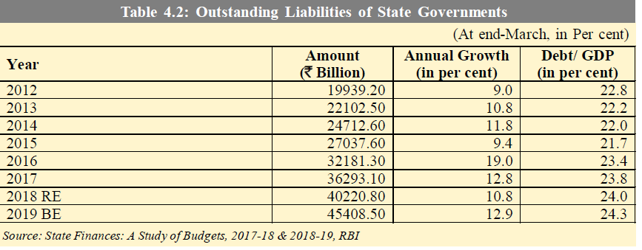
2019: 47867.69 13.6 25.2
2020 (RE): 53430.22 11.2 26.3
2021 (BE): 59893.60 12.5 26.6

Slide 36
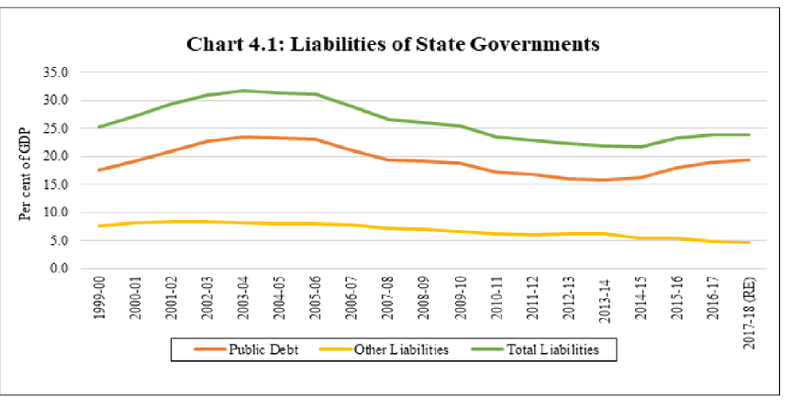

Slide 37
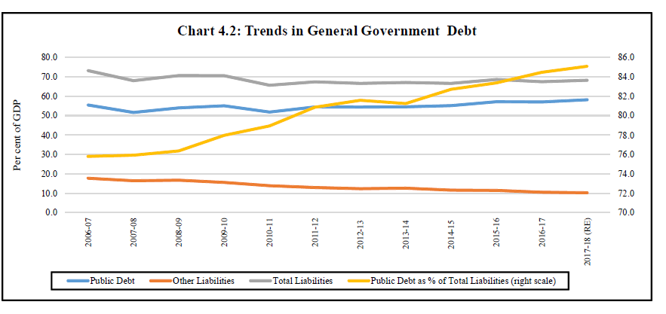

Slide 38
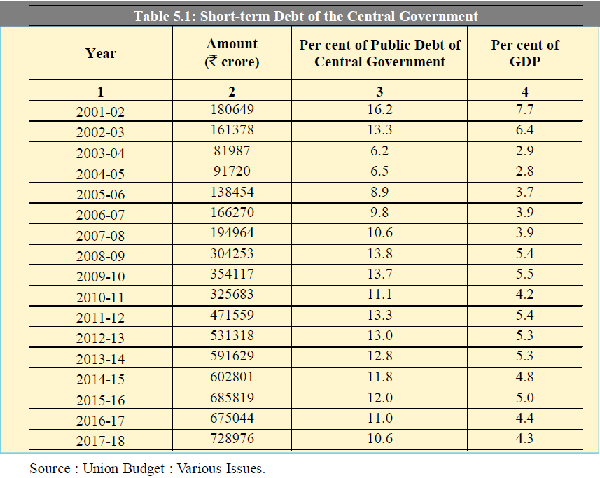
By end June 2020 Public debt of central govt is 101.3 lakh crore.
In 2019 end June it was at 94.6 lakh crore.

Slide 39
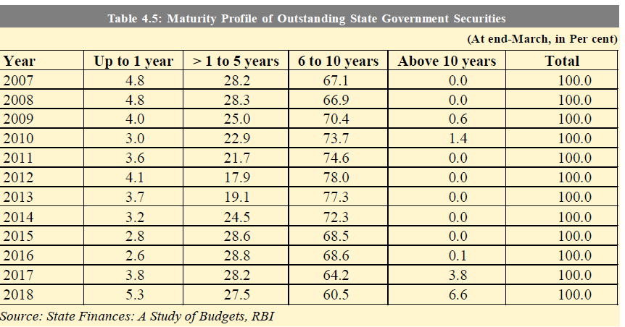
2019: 5.9 26.3 62.1 3.7 100
2020: 5.8 27.2 60.2 6.8 100

Slide 40
Short-term Debt of the general Government
Short-term debt of the General Government comprises short-term debt of Central Government and States after netting out inter-Governmental debt.

Slide 41
Tax structure in India
Since early 1990s, India's tax system has undergone a change from highly interventionist system towards more neutrality
Direct and Indirect tax, with latter dominating
Direct taxes: 95% total direct taxes are collections of corporate taxes and taxes on personal income
Indirect taxes: Consolidated under a goods and services tax (GST). The imp taxes under GST are:
General sales tax
Union excise duties
Special additional duty
Customs duty
Service tax

Slide 42
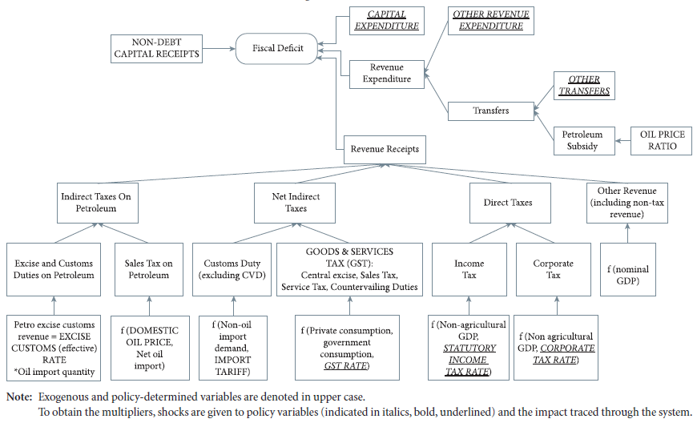
Fiscal revenue receipts and taxes in India

Slide 43
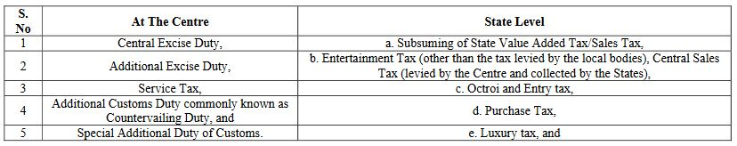
GST
Introduced from 1 April, 2017 - The Constitution Act, 2016
The GST is a Value added Tax (VAT) and is proposed to be a comprehensive indirect tax levied on manufacture, sale and consumption of goods as well as services at the national level
It replaces all indirect taxes levied on goods and services
Dual in nature- State GST and Centre GST

Slide 44
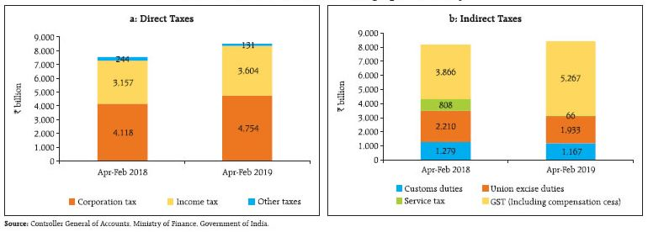
Tax collection
The Monetary Policy Report, 2019 states that,
Gross tax collection fell short of the budget target in 2018-19 (Revenue Expenditure) largely due to GST collections by Rs.1 trillion.
The Centre’s fiscal deficit is 34.2% more than target at the end of Feb,2019

Slide 45
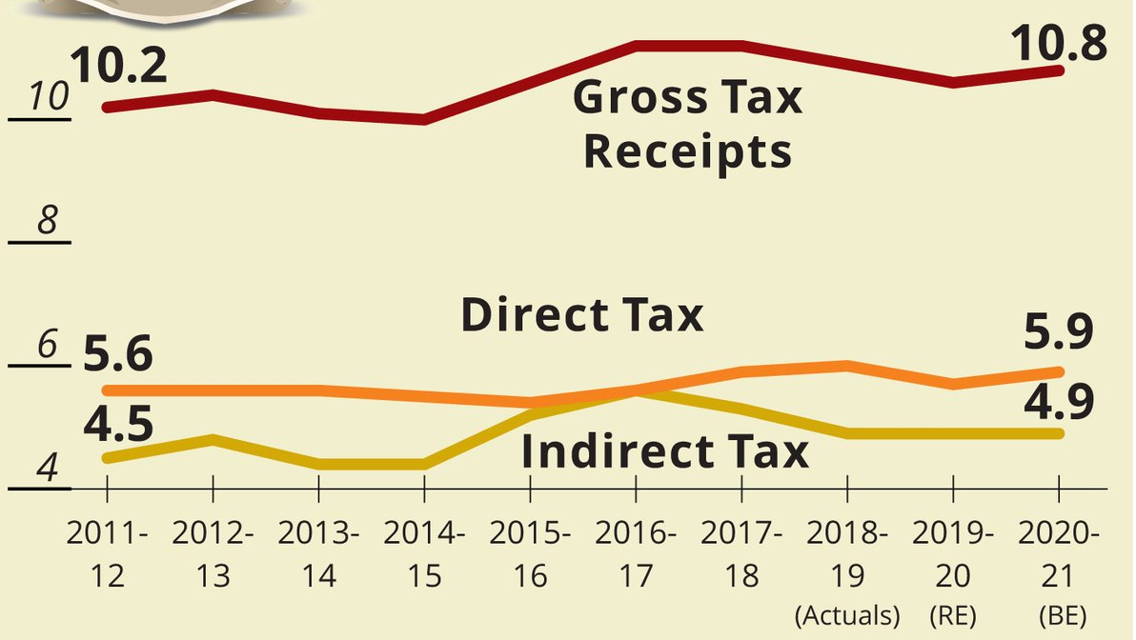
Tax collection in India

Slide 46
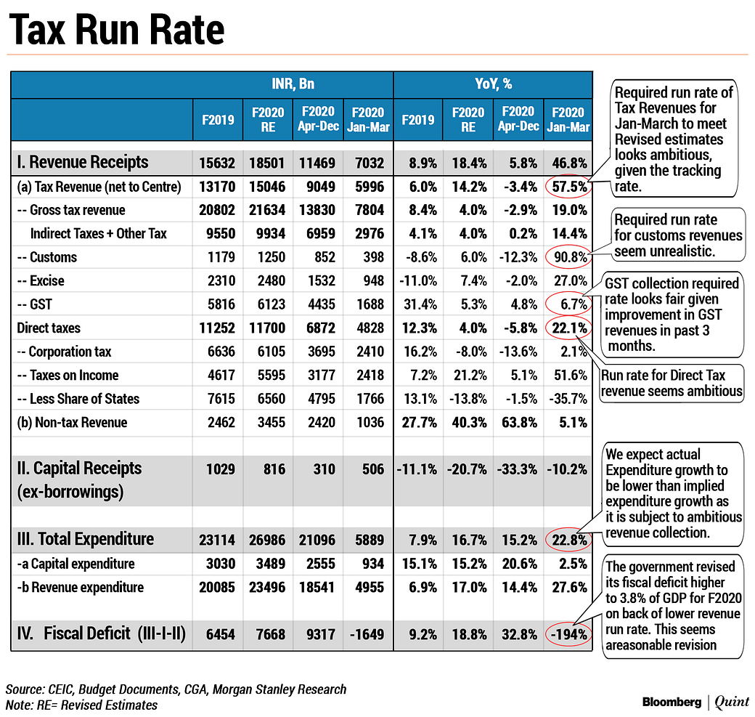
Bloomberg's estimation on India's Tax collection

Slide 47
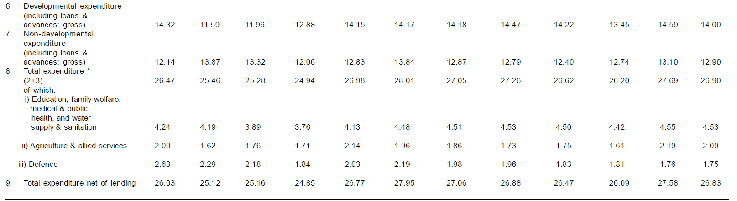
Public Expenditure as % of GDP

Slide 48
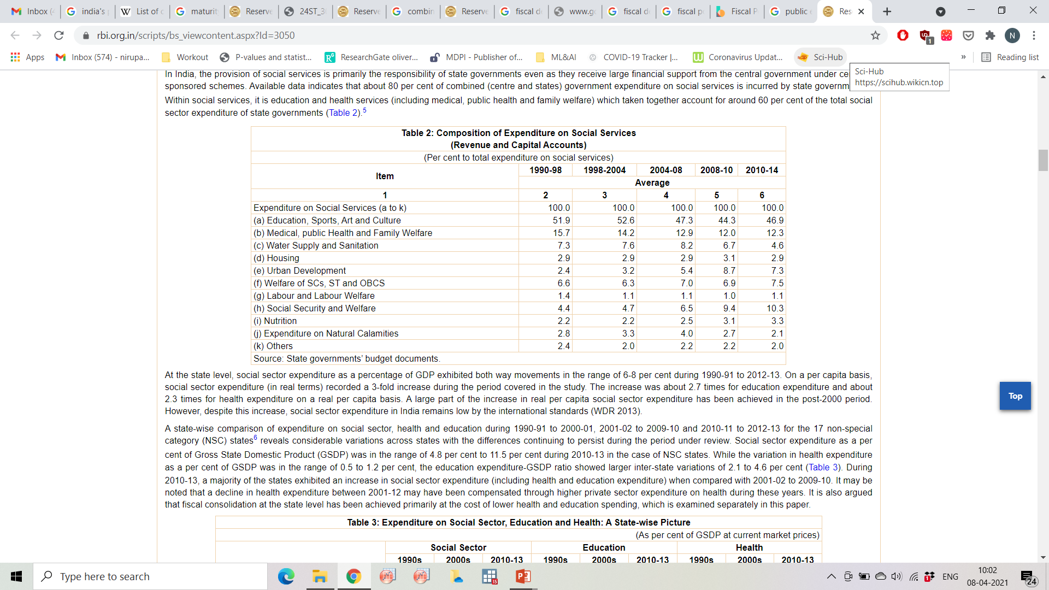
Expenditure on social Services over the years

Slide 49
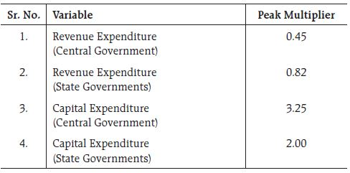
Fiscal Multipliers in India
Fiscal multipliers help to make appropriate fiscal policy decisions and choosing from among various fiscal policy instruments when there is inflationary pressures or when overall growth is faltering
Estimated revenue expenditure multipliers (center and states) are less than unity (RBI, 2019)
A value of 3.25 for the capital expenditure multiplier implies that an increase of Rs.10 million in capital expenditure by the government would raise GDP by Rs.32.5 million, by the end of the year.

Slide 50
Factors affecting Fiscal multipliers in India
Greater trade openness is expected to have a negative impact on the fiscal multiplier as higher imports are a leakage from aggregate demand
From the perspective of debt sustainability, any fiscal expansion can crowd out private demand due to absence of alternative modes of financing and endemic credit constraints
Capacity utilization in the economy is an important determinant of the size of the multiplier
The level of financial development proxied as credit-to-GDP ratio – determinant of multiplier’s magnitude
India has a unique characteristic of perfect substitution between revenue and capital expenditure. Thus, any positive shock to revenue expenditure tends to reduce capital expenditure to the extent of the shock, as well as to reduce private investment with the given fiscal deficit target and, hence, yield a negative revenue expenditure multiplier.

Slide 51
Govt debt externally financed:
Relatively Small
On concessional term
Domestic debt:
Long maturity structure
Low long term rates

Slide 52
Certain Major Concerns needing attention
Quality of public expenditure (Unproductive spending)
Capital expenditure must rise significantly (Infrastructure)
Revenues used for servicing public debt is a concern
Current (revenue) expenditures of the states as a % of GDP outpaces the centre’s
Expenditure on health and education is much lower than required.
Government borrowing is more responsive to revenue expenditure than capital outlay
State-specific factors affecting fiscal performance play an important role in government borrowing.
Mounting wage and pension costs (impact of pay revision)
Populist measures (States play a significant role)
Both tiers offset pressures by a compromise on capital expenditure

Slide 53
Cont….
Agriculture outside the tax net
Tax concession and tax holidays
Not much is done with monetary policy
India’s growth is below potential
As long as output is below potential, public spending can be financed through borrowing from RBI
Fiscal adjustment required at centre and states

Slide 54
Thank You

